Slide 1
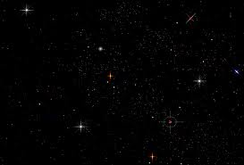
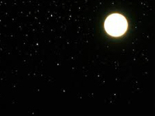
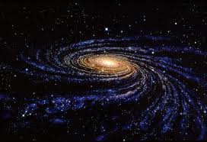
你的名何其美
Your Name is Beautiful
新心音乐

Slide 2
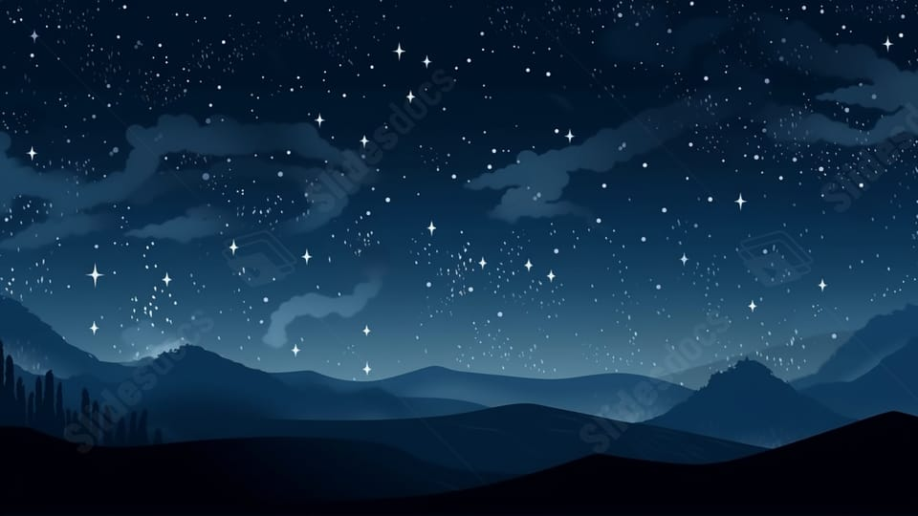
每当夜幕低垂,
举目遥望穹苍
天父, 我发出赞叹
As night falls,
I lift up my eyes and look at the sky
Father, I give praises to You

Slide 3
耿耿银河,
点点繁星明月伴
我不禁要向你俯伏敬拜
Bright stars are accompanied by the moon in the Milky Way galaxy
I can’t help but fall down to worship You.

Slide 4
渺小的人算甚么,
人生何等短暂
天父, 你为何眷顾 ?
What is tiny mankind; human life is so short
Father, why do you care for them?

Slide 5
赐下荣耀尊贵为我冠冕,
统管全地
我不禁要大声来赞美
You give glory and honor as my crown You control all the earth
I can’t help but praise You loudly

Slide 6
你的名在全地何其美！
你的名在全地何其美！
Your name is beautiful in all the earth!

Slide 7
我向你伸出双手,
大声宣告你是主
哦父, 你的名在全地何其美
I stretch out my hands to You I loudly declare that You are the Lord
Oh Father, Your name is beautiful in all the earth!

Slide 8
每当夜幕低垂,
举目遥望穹苍
天父, 我发出赞叹
As night falls,
I lift up my eyes and look at the sky
Father, I give praises to You

Slide 9
耿耿银河,
点点繁星明月伴
我不禁要向你俯伏敬拜
Bright stars are accompanied by the moon in the Milky Way galaxy
I can’t help but fall down to worship You.

Slide 10
渺小的人算甚么,
人生何等短暂
天父, 你为何眷顾 ?
What is tiny mankind; human life is so short
Father, why do you care for them?

Slide 11
赐下荣耀尊贵为我冠冕,
统管全地
我不禁要大声来赞美
You give glory and honor as my crown You control all the earth
I can’t help but praise You loudly

Slide 12
你的名在全地何其美！
你的名在全地何其美！
Your name is beautiful in all the earth!

Slide 13
我向你伸出双手,
大声宣告你是主
哦父, 你的名在全地何其美
I stretch out my hands to You I loudly declare that You are the Lord
Oh Father, Your name is beautiful in all the earth!

Slide 14
你的名在全地何其美！
你的名在全地何其美！
Your name is beautiful in all the earth!

Slide 15
我向你伸出双手,
大声宣告你是主
哦父, 你的名在全地何其美
I stretch out my hands to You I loudly declare that You are the Lord
Oh Father, Your name is beautiful in all the earth!

